Slide 1
Data science overview

Slide 2
content
What is data science
uses of data science
Probability theory

Slide 3

What is data science?
From Wikipedia – Data science is an interdisciplinary field of scientific methods, processes, algorithms and systems to extract knowledge or insights from data in various forms
My own definition – where you can predict the future using the past, kind of like crystal ball

Slide 4
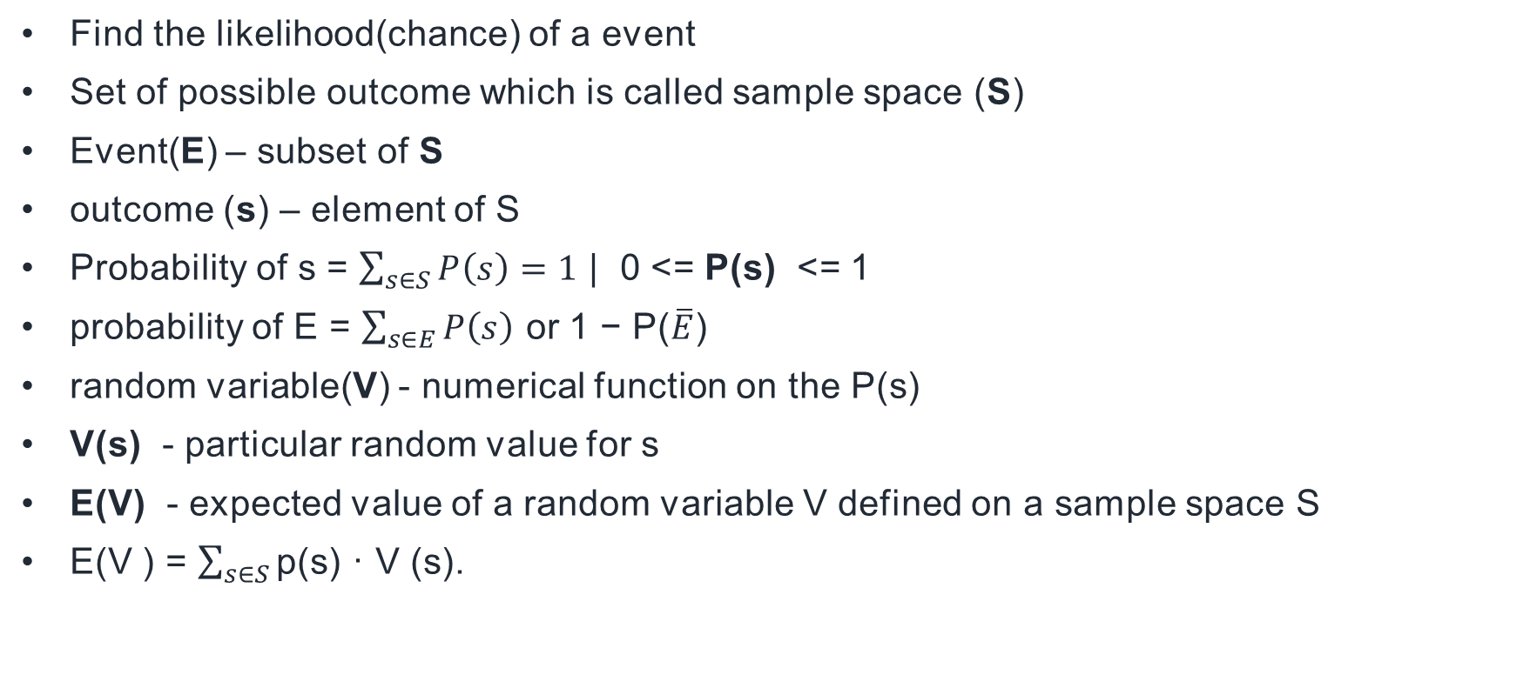
Probability theory
Find the likelihood(chance) of a event
Set of possible outcome which is called sample space (S)
Event(E) – subset of S
outcome (s) – element of S
Probability of s = $\sum_{s∈S}{P\left(s\right)=1}$ | 0 <= P(s) <= 1
probability of E = $\sum_{s∈E}{P\left(s\right)}$ or 1 − P($\overline{E}$)
random variable(V) - numerical function on the P(s)
V(s) - particular random value for s
E(V) - expected value of a random variable V defined on a sample space S
E(V ) = $\sum_{s∈S}{\text{p}\text{(}\text{s}\text{) · }\text{V}\text{ (}\text{s}\text{).}}$

Slide 5
Compound Events and Independence
A − B - Set of outcome of A which are not outcomes of B
A ∩ B – Intersection – Outcomes in common in both A and B events
A ∩ B = A − (S − B)
A ∪ B - Outcomes which appear in either A or B
A = S−A – Complement operation
The events A and B are independent if and only if - P(A ∩ B) = P(A) × P(B)

Slide 6
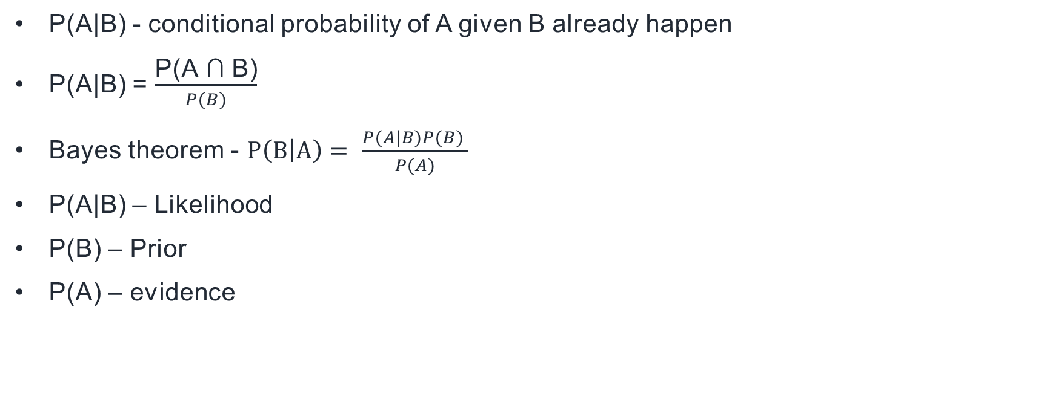
Conditional Probability
P(A|B) - conditional probability of A given B already happen
P(A|B) = $\frac{\text{P}\text{(}\text{A}\text{ ∩ }\text{B}\text{)}}{P(B)}$
Bayes theorem - $P\left(B | A\right)= \frac{P(A|B)P(B) }{P(A)}$
P(A|B) – Likelihood
P(B) – Prior
P(A) – evidence

Slide 7
Two Content Layout with SmartArt
First bullet point here
Second bullet point here
Third bullet point here
Group A
Task 1
Task 2
Group B
Task 1
Task 2
Group C
Task 1
Task 2

